Slide 1
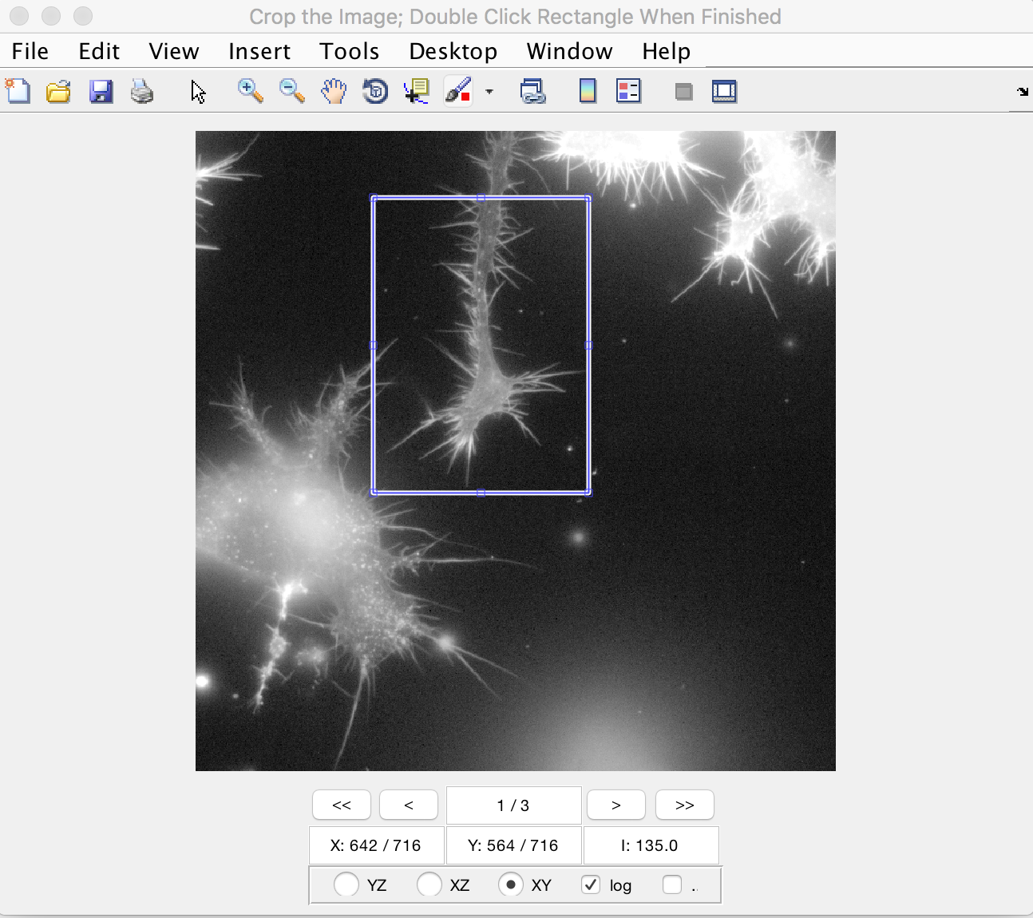
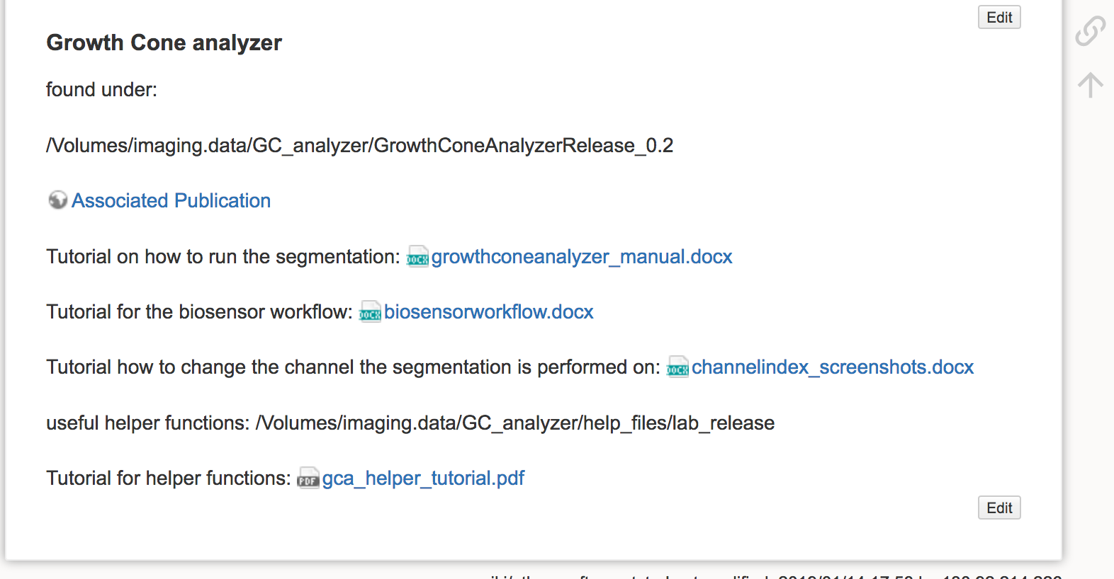
The GCA in praxis
1.
Native work flow:
Crop individual growth cones from your images
Run segmentation
Inspect the results
Run biosensor analysis
Create groups for clustering (separate step for segmentation and FRET)
Extract features for figures
Create figures
2.
4.
On the wiki under software:
7.

Slide 2
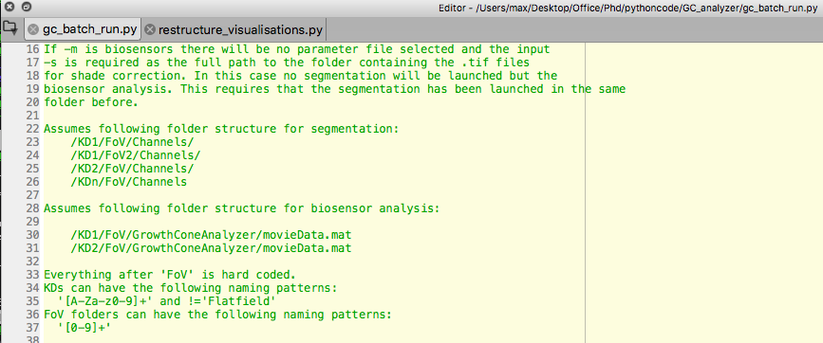
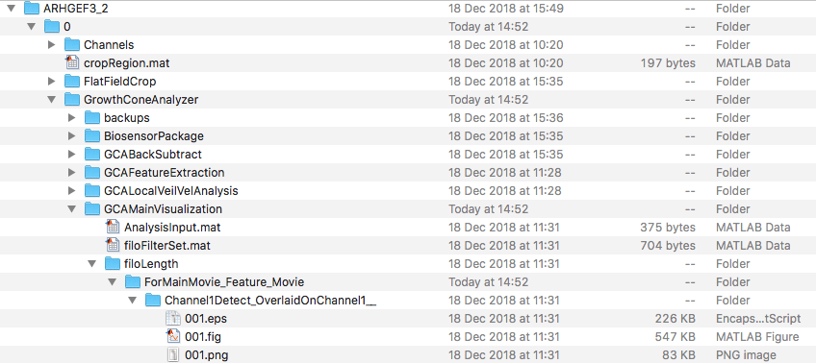
The GCA in praxis
Powerful software but hard to work with the output
Two main helper functions:
gc_batch_run.py
restructure_visualizations.py
Path to the segmentation files of an individual movie

Slide 3
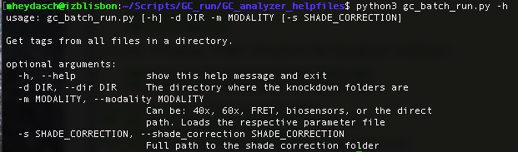
The GCA in praxis
Powerful software BUT quite clunky
Natively:
-Does not support batch processing
-Requires manual inspection but necessary files
are buried deep within folders
Solved:
✓
✓
Two helper functions:
gc_batch_run.py
Accepts as inputs:
-h to show the help documentation at the side
-d, the directory where your cropped images are stored
-m, the modality you want to image with (this determines the segmentation parameter file that will get loaded. This is hardcoded
for 4 default ones. Alternatively one can give the full path to a different file)
-s, the directory where your shade correction files are stored. This is only applicable for the biosensors modality
A call can look something like this:
python3 gc_batch_run.py -d /home/mheydasch/myimaging/Experiment1 -m 60x
This is not starting any computation but creates files that slurm will use to start the batch processing in:
./job_files
To start the batch process you then have to type:
slurm job_files/batch.sl

Slide 4
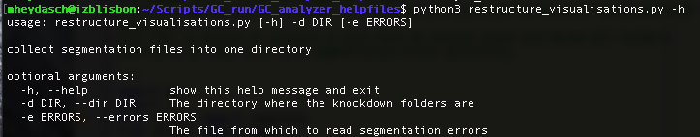
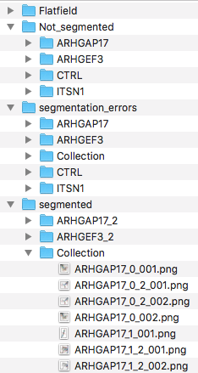
The GCA in praxis
Powerful software BUT quite clunky
Natively:
-Does not support batch processing
-Requires manual inspection but necessary files
are buried deep within folders
Solved:
✓
✓
Two helper functions:
restructure_visualisations.py
Accepts as inputs:
-h to show the help documentation at the side
-d, the directory where your analyzed images are stored
-e, the text file that contains your annotated filenames
If only –d is parsed it will search for the png files of the segmentation and copy them
all together into a folder Collection, keeping a unique name for each of them.
In addition it will take all folders where no segmentation files could be found and moves them
to a folder Not_segmented
You can then observe the images and create a .txt file with those that have segmentation errors.
Simply put the name of the image without frame number and extension into the text file.
Put one name per line only!
Works independent of the amount of subfolders.

Slide 5
Other functions
Python:
restructure_actin.py: Takes the first image of channel1 of each cropped movie
and copies it into a collection folder
restructure_graphs.py: Takes all .png files in the current folder (preferential output of the graph folder)
and copies them into a collection folder
restructure_fret.py: Takes all .png files in the FRET output folder and copies them into a collection folder
analyze_features.py: Creates objects containing all the features from the input experiments and creates
interactive graphs in plotly. Analogous to the groupData analysis package in MATLAB.

